Slide 1
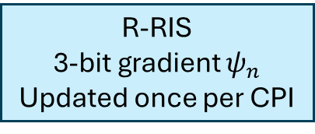
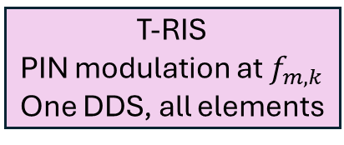
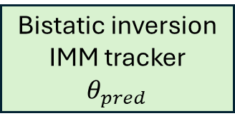
CW source
28 GHz, 20 dBm
T-RIS
PIN modulation at $f_{m,k}$
One DDS, all elements
near field
R-RIS
3-bit gradient $ψ_{n}$
Updated once per CPI
M-FSK beam
target
Echo
Beam command (SPI)
Rx ULA, 16 el.
I/Q down-conversion,
Per-symbol correlator
Coherent 2-D processing
Path, Doppler, angle
(peak refinement)
Bistatic inversion
IMM tracker
$$θ_{pred}$$

Slide 2
